Slide 1


Technical Writing and Presentation How to write scientific texts in English
TRƯỜNG ĐẠI HỌC BÁCH KHOA HÀ NỘI
HANOI UNIVERSITY OF SCIENCE AND TECHNOLOGY
SOICT - 2020

Slide 2
Contents
Simple rules for writing
Parts of a sentence
Sentence
Combining clauses
Punctuation

Slide 3
Simple rules for writing
Have one idea per sentence or paragraph and one topic per section.
Have a straightforward, logical organization.
Use short words.
Use short sentences with simple structure.
Keep paragraphs short.
Avoid buzzwords, clichés, and slang.
Avoid excess, in length or style.
Omit unnecessary material.
Be specific, not vague or abstract.
Notes:
Break these rules if there is a good reason to do so. Sometimes a long word or a complex sentence is the best option. Use these when necessary, but not otherwise. Another common fault in science writing is to overqualify, that is, to modify every claim with caveats and cautions. Such writing is a natural consequence of the scientist’s desire to not make unfounded claims, but it can be taken too far.

Slide 4
Parts of a sentence
Skeleton
verbs
nouns
pronouns
numerals
adjectives
Additional stuff
Adverbs
Prepositions
Conjunctions.
Notes:
Adverbs modify verbs, adjectives, or other adverbs,
Conjunctions join words, clauses or sentences together.
Prepositions are always connected to other words (nouns, pronouns, or verbs in -ing form).
Prepositional phrases (”in the beginning”, ”through a gateway”) are used in the same way as adverbs

Slide 5
Verbs
Two important rules
The number of subject determines the number of verb
Do not mix inconsistent tenses
Uses of verbs
Number and person
Active or passive voice, which person?
Tenses
Noun syndrom
Irregular verbs
Notes

Slide 6
Number and person
When the subject is singular third person (she/he/it), the verb needs suffix -s
The auxiliary verbs have their own special forms (is, can, has, does).
When the subject is composed of a singular and a plural noun by ”or” or ”nor”, the verb agrees with the noun that is closer.
Notes:
suffix -s (in the present, positive sentence).

Slide 7
Notes
Be careful with special phrases:
”A number of new experiments were done” (plural) ”Plenty of time was spent...” (singular) ”A few data points belong to cluster X” (plural)
If the number of the subject changes, retain the verb in each clause.
✗The positions in a sequence were changed and the test rerun
✓The positions in the sequence were changed, and the test was rerun.

Slide 8
Tenses
Default: the present
It is possible to combine perf ect (has been) (and future, will be) if needed, but not the other tenses
Past or present prefect (but not both) when you describe previous research (literature review)
Past tense to describe the experiments and their results
Notice: Use ”would” with care! It expresses a conditional action.
E.g.”it would appear” → ”it appears”

Slide 9
Active voice vs passive voice
It is often recommended to use active voice,
In scientific writing passive voice is sometimes convenient.
Passive voice allows us to draw the reader’s attention to the phenomenon or the event, instead of the actor.
E.g.
”The probabilities are updated by Bayes rule”,
”The score is assessed on the basis of the training data.”
Often the purpose determines the voice.
Notes:
In active voice the actor is known, while in passive voice it is unknown.
In the basic form of passive (”sg is done”), you can express also the actor (”sg is done by sy”). Expressing the actor is always more informative!

Slide 10
Passive voice
Usually we want to begin with a familiar word and put the new information in the end.
E.g. before an equation or a definition, we can say ”The model is defined as follows”
Do not overuse passive, and do not chain passive expressions.
Use only one passive per sentence

Slide 11
Passive expressions
”It is”
E.g. ”It is often recommended [reference] that...”
Typical verbs in this expression are: say, suppose, consider, expect.
“We” can be used as passive.
E.g. ”In Chapter X, we define the basic concepts.”
should be replaced with
”The basic concepts are defined in Chapter X.”
Notes:
A formal subject ”it” is sometimes used in passive expressions:

Slide 12
Other expressions
”You” is sometimes used as passive, especially in manuals. Don’t use it in scientific text!
”People” when you refer generally to people. Quite a vague expression, not recommendable!
”There is/are” is used when the real subject (what is somewhere) comes later and we haven’t mentioned it before.
E.g. ”There was only one outlier in the data set 1” v.s. ”The outlier was in the data set 1.
”The verb is nearly always ”be” (sometimes ”exist” or something else)
Notes:
Outlier: điểm dị biệt

Slide 13
Person
Basic rule: avoid the first person.
Referring to yourself: you can talk about ”the author”.
E.g. ”All programs have been implemented by the author”
Gender-neutral language: when you refer to an unknown user, student, etc. try to use gender-neutral language.
– The most common way is to say ”she/he” or ”he or she – ”One” is neutral, but sounds often awkward.
E.g. ”The learner can define one’s own learning goals”
Sometimes you can avoid the problem by using plural
Notes:
1/(no opinions, but facts). However, sometimes we can use ”we” as a passive expression
2/ Notice that I don’t guarantee that your supervisor likes this! Some supervisors prefer ”I”.
3/”. Some authors are careful about the order of her/him, as well! E.g. you can use every second time ”she or he” and every se
cond time ”he or she”. Remember to put the other pronouns in the same order (”She/he tries her/his best”)
awkward. : vụng

Slide 14
Notes
Do not use short forms ”isn’t, can’t, doesn’t”, but ”is not, cannot, does not”.
Use ”be verb+ing” form when something is currently happening or takes some time.
E.g. ”Thread 2 can be started in the same time when thread is still running”
Some verbs require that the following verb is in -ing form
E.g.”Continue splitting until criterion X has been reached.”
”Noun syndrom” = use of common verbs {be, do, have, make, ...} + a noun ⇒ Prefer illustrative verbs!
E.g. ”We can get better understanding...” ⇒ “We can understand better”
Notes:
2/enjoy, avoid, succeed in, finish, keep, mind, practice, risk, continue

Slide 15
Nouns
Plural forms
Countable and uncountable nouns
Differences between British and American English

Slide 16
Plural Forms
Irregular plural forms
Singular form | Plural form | Singular form | Plural form
half | halves | analysis | analyses
life | lives | thesis | theses
axis | axes | parenthesis | parentheses
matrix | matrices | basis | bases
child | children | emphasis | emphases
automaton | automata | series | series
vertex | vertices | medium | media
index | Indices (indexes) | criterion | criteria
appendix | appendices (appendixes) | phenomenon | phenomena

Slide 17
Special cases
Data is originally the plural form of datum, but nowadays it is frequently used as a singular word.
The same holds for hypermedia.
E.g.
”The data is biassed”,
”Hypermedia offers a new way to implement learning environments”

Slide 18
Notes
If the suffix is {-s,-ss,-sh,-ch,-x,-z} in singular → -es in plural, E.g. research – researches, approach – approaches, quiz – quizzes
The same happens with most words which have suffix -o, unless the word is abbreviated or of foreign origin.
E.g.cargo – cargoes,
but photo – photos, dynamo – dynamos
After consonant -y changes to -ies in plural.
E.g. floppy – floppies.
Singular words which look like plural forms The names of disciplines: mathematics, statistics, physics. ”Statistics is the precessor of data mining.”
Notes:
news is also singular! ”Good news is that the algorithm works in O(n) time”

Slide 19
Uncountable nouns
Words expressing material: water, air, wood, ...
Abstract words: life, time, work, strength, ...
Exceptional: advice, information, news, equipment, money (Plural meaning)
Notes:
The words in group 3 are grammatically singular but they have also plural meaning. If you want to refer to a singular piece you have to express it in another way: ”a piece of information”, ”an item of news”, ”a bit of advice”. ”This information is important”! ”All advice is good!

Slide 20
Compound words
The practices vary, possibly words are written together, with a hyphen -, or separately.
If the words have become one concept, they are usually written together, e.g. ”software”, ”keyboard”, ”database”
If the independent meaning of words is emphasized, they are hyphened, e.g. ”non-connected”
Hyphen is often used when the concept consists of more than two words: ”depth-first search”, ”between-cluster variation”, ”feed-forward neural network”, ”first-order logic”
Multiple word adjectives are usually hyphened, e.g. ”data-driven”, ”model-based”, ”class-conditional”
If the first part is a symbol or an abbreviation, the word is hyphened, e.g. ”NP-complete”, ”k-nearest neighbour method”, ”3-dimensional”
Notes:
Problem: how should we spell the following computer science terms? overfitting, nondeterministic, time demanding, drop-out, EM-algorithm

Slide 21
Articles
Position
Definite and indefinite concepts
Basic rules of using articles

Slide 22
Position
Basic rule: before the noun phrase
Exceptions:
{what, such, quite, rather, half} + a/an + noun phrase
E.g. ”Too great a distance”, ”so long a time”
{too, as, so, how, however} + adj. + a/an + noun
E.g. ”as big a difference”
{all, both, double, twice, half} + the + noun
E.g. ”All the methods”

Slide 23
Definite and indefinite concepts
A concept is indefinite, when you mention it first time, and it is not clear from the context
E.g.”There was a time delay between processes A and B.”
It is definite, when
you mention it again
the context defines what you mean
the concept is familiar to everybody
Usually this kind of expressions are defining: ”The delay between two processes P1 and P2 is tend(P1) - tstart(P2).”
Notes:
you mention it again (”The time delay was about 10 ms”)
the context defines what you mean (”The left-most bit is always 1.”,”The result of process A were correct.”)
the concept is familiar to everybody (the Earth, the sun, the moon)

Slide 24
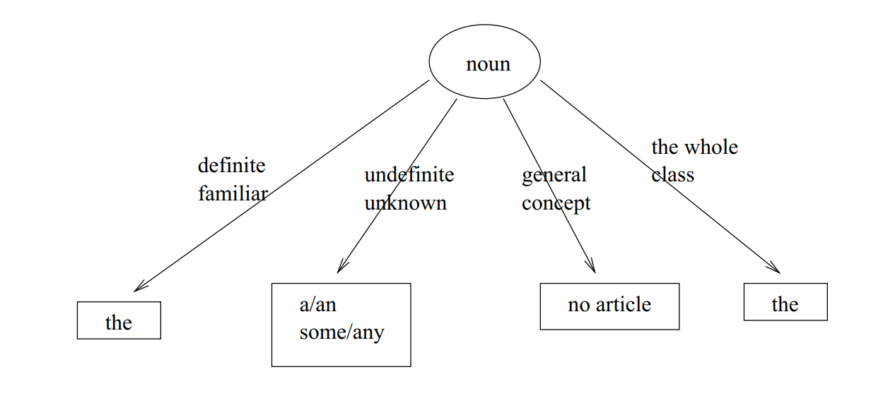
Basic rules of using articles

Slide 25
Refer to an indefinite concept
a singular countable noun → a/an
a plural countable noun + positive clause → some
a plural countable noun + negative or interrogative clause → any
a uncountable noun + pos. clause → some
a uncountable noun + neg. or interr. clause → any

Slide 26
Notes
When you refer to something generally a plural countable noun or a uncountable noun → no article ”Students need time to process new inforsmation”
When you refer to the whole class a singular countable noun → a/an ”The computer cannot solve all problems”
Exceptional expressions Sometimes you can use a/an article with an abstract word:
when the word is proceeded by a describing relative clause ”There is a danger that the model overfits”
expressions ”a /short/long time”, ”a while”
Notes:
2/which means that none of the computers can solve all problems, the property concerns the class of all computers)

Slide 27
“the” article with ordinal numbers and some adjectives
Definite article ”the” is used
when the noun is preceded by an ordinal number
”The first attribute describes...”
when the noun is preceded by an adjective expressing order
”the next attribute”, ”in the following chapter”
with adjectives same, only, right, wrong
”The results were the same”, ”The only model which has this property is X”
Notice: ”the” is not used with ordinal numbers or adjective ”last”, when you refer to the performance in a competition
”Program X came first and program Y was last when the programs were compared by the Z test.

Slide 28
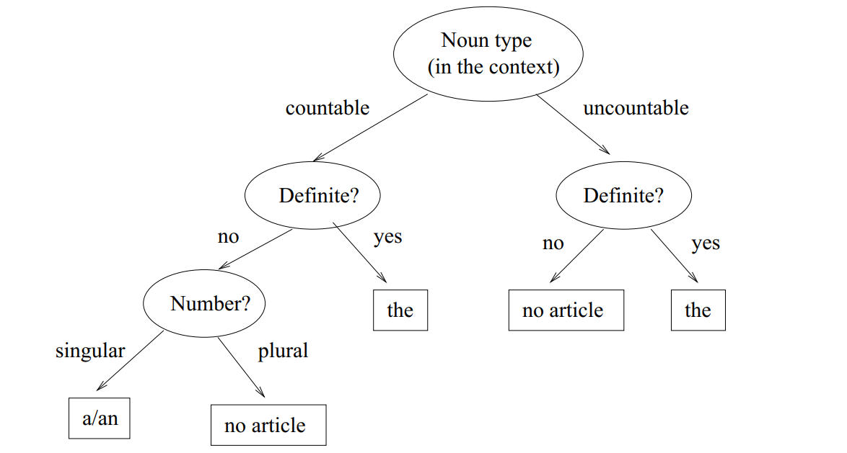
Decision tree for articles

Slide 29
Notes
A noun can be used as a countable or an uncountable concept ”It takes time...”, ”all the time”, ”one at a time”, ”many times”
any or some before the noun, → indefinite” ,
E.g.”The disk contains (some) space for back-up files”
Don’t use pronouns!”This x” → ”the x” (where x is a noun)
∃x ∈ C such that P(x), use article a/an. ”
∀x ∈ C,P(x), use article the. (only for countable concepts!
A name without any modifying word → no article,
E.g.”X is independent from Y “
A modifying word like ”set”, vector”, ”model” etc. stands before the name → Two habits:
1. No article when you mention the entity for the first time. After that use definite article ”the”, or 2. Never any articles.
Notes:
2/. This means that you cannot use article ”the

Slide 30
Pronouns
Two important rules when you use pronouns:
1. When a pronoun refers to a noun in the preceding sentence, make sure that the referred is obvious! 2. Each pronoun should agree with the referent in number and gender.

Slide 31
Notes
Pronouns which require singular verb form {everybody, anybody, nobody, everyone, anyone, no one}
Every + singular noun
All + singular or plural noun
several < many several ≈ some

Slide 32
Adjectives
Two notes: 1. Avoid vague adjectives! 2. How to derive and use comparative and superlative forms?

Slide 33
use the comparative
Basic structure:
X is as efficient as Y (X and Y are equally efficient)
X is more efficient than Y
Exceptional expressions:
X is different from Y
X is similar to Y
X is the same as Y
X is inferior/superior to Y
X is equal to Y
Notes:
make clear what you are referring! ”Problem X is easier to solve” (than what?)

Slide 34
Adverbs
Use as few adverbs/prepositional phrases as possible!
→ expressive verbs and nouns
Use introductory adverbs like ”fortunately, similarly, conversely, certainly” carefully
Notice that ”importantly” and ”interestingly” are not proper adverbs. E.g. ”More importantly, the accuracy can actually increse when the complexity is reduced” → ”More important, the accuracy can actually increase when the complexity is reduced.” ”Interestingly, we found that...” → ”An interesting finding was that...”
Notes:
2/as a synonym to expressions ”it is fortunate” or ”in a similar manner”. Drop them if they are not needed.

Slide 35
Special cases of adverbs
still and yet
Still: before the main verb, but after be-verb.
”These enlargements are still unimplemented”
Yet: at the end.
”These enlargements have not been implemented yet.
so and such
So: before adjectives or adverbs which are not succeeded by nouns
E.g. ”The time complexity is not so hard”
Such: when an adjective is succeeded by a noun.
E.g. ”Such time complexity is infeasible”
Notice the article ”a/an”, if the noun is countable:
”such a system”
”such an algorithm
Notes:
Still (mostly in positive sentences)
Yet (mostly in negative or interrogative sentences)

Slide 36
Prepositions
Be careful with prepositions. A wrong preposition can give a totally different meaning! • Hint: When you use a preposition, visualize the direction it is signaling and ask yourself if it is appropriate. • If you are unsure about the use of a preposition, ask yourself what a cat would do! (Fedor’s sciwri book) Cats sit on mats, go into rooms, are part of the family, roam among the flowers

Slide 37
Expressing location
Usually in, e.g. ”in set X”
If an exact location, then at, e.g. ”at point (x, y)”
If the location can be imagined as a line or a surface, then on ”on the x-axis”, ”on a time line”
Special cases:
”on page 3”, ”on line 5”, ”on the Internet”
”A file is loaded from the hard disk into main memory.”
”results from the survey suggest...”
over – under/beneath
above – below
”X’s points were below the average points” ”The task is to optimize f under the given constraints”

Slide 38
Expressing time
Exact time: at, e.g. ”at the moment”, ”at four o’clock”, ”at the same time”
Longer period of time: in, e.g. ”in the 1970’s”, ”in the future”, ”in five minutes”,
Notice: ”In the beginning/end” vs. ”At the beginning/end” of something

Slide 39
Expressing the target or the receiver
to or for?
Basic rules:
When direct receiver, then to ”The values are assigned to variables”
When the final receiver (for whom something is meant) then for ”I gave the book for Belinda to Tersia” ”The messages for nodes F and G are transfered to node D for rerouting” ”A variety of methods have been developed for the clustering problem.” • When something is good or bad for something, then for ”Problem-based learning is good for students”

Slide 40
Expressing the target or the receiver
Some verbs require either for or to: 1. If the verb is {bring, give, take, show, offer} → to 2. If the verb is {be, get, keep, make} → for
Sometimes the preposition can be missing, depending on the word order: i) verb + receiver + object ii) verb + object + to/for + receiver iii) verb + to/for + receiver (no object)
Notes:
If the verb is tell, then always case i. • If either object or receiver is pronoun, then the pronoun becomes before the noun (case i or ii) • If both are pronouns, then the object becomes first (case ii) • If the verb is {belong, describe, explain, introduce, reply, say, speak, suggest} → always to (cases i–iii)

Slide 41
Special phrases
constraint on something
independent from something but dependent on something
different from something but similar to something
difference between something and something
prefer something to something
impact of something on something influence on something effect on something (but to affect something) focus on something perform in some manner generalize to something a discussion about/on something
research on something but a study of something reason for something
opportunity of/for something
in spite of something (but despite something) regardless of something take into account in relation to something in contrast with something a proportion of something. (”a large proportion of data”) in proportion to something, proportional to something (”The time complexity of f proportional to n is...”) the ratio of a to b = a/b x% of y under some conditions by default contrary to something in contrast by contrast (∼ ”however”) on the contrary at an extreme
Notes:
Examples: ”The model is linear in the number of variables k.” ”There are various reasons for this.” ”See [Ref] for details.”

Slide 42
Parallel structures
Parallel structure = words, phrases, clauses or sentences combined by commas and/or conjunctions.
Here we call the combined items as parallel items.
Parallel items are combined by parallel conjunctions (and, or, but, ...).
lists are also parallel structures!
Often the parallel structure lists alternatives or makes some kind of comparison: the items belong to the same or similar classes or to two opposite classes.
E.g. ”Method X has several advantages: it is easy to implement, it works in polynomial time, and it can use both numeric and categorial data.” contains two parallel structures: three advantages (”it is, it works, it can”) in a list and ”both numeric and categorial data”
Notes:
three advantages (”it is, it works, it can”)

Slide 43
Basic rules for parallel structure
The parallel structure should be consistent in two ways
Semantically: the concepts referred by parallel items should be comparable
Syntactically: the items should have similar grammatic structure. All of them should be either nouns, noun phrases, verb phrases, or clauses.
Parallel items should be in the same form, e.g. you cannot combine ”to” + verb and a verb without ”to”.
E.g. ”The problem is both hard to define and solve” → ”The problem is both hard to define and to solve

Slide 44
conjunction pairs
Parallel items combined by conjunction pairs
between...and,
both...and,
either...or,
neither...nor
not only...but…(also)
”X solves the problems of traditional clustering algorithms. Neither outliers nor missing values affect the clustering quality.” ”The task is not only easy to solve but it can also be solved efficiently

Slide 45
The comparative – the comparative
the + comparative + x + comma + the + comparative + y, where x and y complete the clauses ”The more complex the model is, the better it describes the training data.”

Slide 46
Parallel sentences
The sentences in the list begin by ordinal numbers ”First, Second, Third”
”X model has three important properties: First, the model structure is easy to understand. This is a critical feature in adaptive learning environments, as we have noted before. Second, the model can be learnt efficiently from data. There are feasible algorithms for both numeric and categorial data.Third, the model tolerates noise and missing values.”
Notes:
you can say ”Firstly”, but there is no need for that!

Slide 47
Sentences
Terminology
Sentence styles
Types of dependent clauses
Sentence length
Word order
Combining clauses

Slide 48
Terminology
A sentence consist of one or more clauses
A clause contains always a subject and a predicate, and usually an object – An independent clause (main clause) can make a sentence alone. – A dependent clause (subordinate clause) needs an independent clause for support

Slide 49
Sentence types
The sentence type depends on the type of its main clause. The main types are following:
1. Statement (ends by a full stop: ”x is y.”)
2. Question (ends by a question-mark: Is x y?”)
3. Order (ends by an exclamation mark: ”Be x y!)
In scientific writing the default type is the statement.
Direct questions and orders are seldom used.
Questions suit best to the introduction where you state your main research questions clearly and concretely

Slide 50
Types of dependent clauses
Clauses beginning by sub-ordinating conjunctions (when, if, because,while, ...)
Relative clauses (begin by relative pronouns which, who, that)
Indirect questions (begin by question words or if/whether)
Examples:
”The dependency is trivial, because Y = f(X).” ”X and Y are linearly independent, if the correlation coefficient, corr (X, Y ), is zero” ”Let ci be the cluster which is closest to x. ”We select the first model that fits the data.” ”First we should study what is the relationship between X and Y .” ”The main problem is whether X can be applied in Z.” ”We analyze the conditions under which X can be applied.”

Slide 51
Sentence length
always less than 30 words, preferably less than 20 words!
1-3 clauses
expresses one idea
If you tend to write too long sentences, try the following:
Identify the main subject-predicate-object section
Prune or compress everything else, which is not needed
Check the verb structures and ask yourself if they could be shorter
Notes:
E.g. verb structure ”has been shown” can often be replaced by ”is”. Notice! Don’t go into the other extreme when you shorten sentences! If the clarity suffers, then a longer sentence is better.

Slide 52
Word order
The order of words has a strong impact on the meaning!
E.g.
”There is, however, currently no information about the limitations of quantum computers.” →
”However, there is no current information about the limitations of analog computers.” →
”However, the limitations of current quantum computers are not known.”

Slide 53
Word Order
Look at 3 examples:
”There is, however, currently no information about the limitations of quantum computers.” ”However, there is no current information about the limitations of analog computers.” ”However, the limitations of current quantum computers are not known.”
Notes:
The order of words has a strong impact on the meaning!

Slide 54
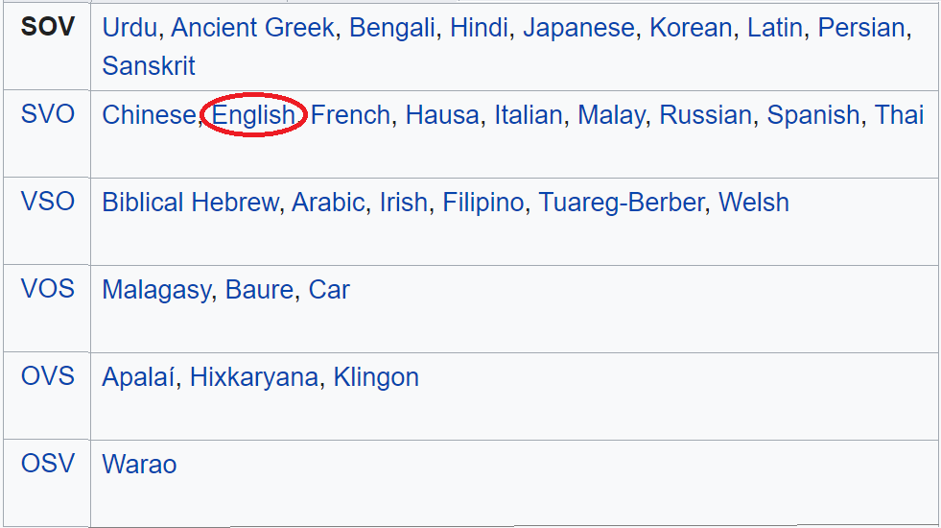
Word order in different languages

Slide 55
Basic Word Order
subject-predicate-object (SVO)
You can add attributes, phrases and clauses, but don’t deviate too far from the basic format
Goal: put the most important information to the beginning of a sentence or begin by a familiar thing and put the new information to the end
E.g. ”X is a new algorithm for the TS problem” ”The probabilities are updated by the Bayes rule:” + the equation.
Often the sentence is most informative, if you express the most important topic by the subject.
This format helps to write clear and compact sentences
Notes:
TS Problem: Travelling Salesman Problem

Slide 56
More details about word order
The adverbs and prepositional phrases occur in order: way, place, time
”The nearest neighbours can be identified efficiently (way) in a dendrogram (place)”.
”The values can be updated easily (way) in linear time (time)”. Verb modifiers: in the middle of clause
Adverbs which express frequency: always, ever, never, often, seldom, sometimes, usually
Adverbs which can begin the clause If the adverb expresses time, it can be also in the beginning: ”Next, the data is loaded to the main memory.” This gives more emphasis to the word. It is also used, when there are other adverbs/prepositional phrases in the end of the clause. Introductory adverbs like ”obviously”, ”fortunately”, etc. are always set to the beginning (if they are needed)
Notes:
Verb modifiers are located • before the predicate, if the verb consists of one word and is not the ”be”-verb. • after the first auxiliary verb, if the verb consists of several words. • always after the ”be”-verb. E.g. ”X often implies Y .” ”The method gets sometimes stuck at a local optimum” ”The data was probably biased.” Task: Draw a decision tree for deciding the position of adverbs! Problem: some words like ”only” can modify also other words! → Put the word ”only” next to the word or phrase it modifies! E.g. (notice the different meaning): ”X was the only method which could parse the LL(1) grammar” ”X was the method which could only parse the LL(1) grammar” ”X was the method which could parse only the LL(1) grammar”

Slide 57
Combining clauses
Say the main message in the independent clauses! Use dependent clauses only to add details
Contents
Combining two independent clauses
Combining clauses by sub-ordinating conjunctions
Relative clauses
Indirect questions

Slide 58
Combining clauses by sub-ordinating conjunctions
The basic form: an independent clause + a sub-ordinating conjunction + a dependent clause.
The most common sub-ordinating conjunctions express
a chronological order: when, as, as soon as, while, after, before,until, since
”The search can be halted as soon as minfr proportion of data is checked”
a conditional relationship: if, unless. If-clauses can also begin the sentence
”If the order is fixed, the episode is called serial.”
a reason: because (Recommendation: reserve word ”since” to express chronological order)
”The method is time-efficient, because all the parameters can be updated in one loop
a purpose: so that (You can also use in order to + infinitive verb)
an admission: although, even if

Slide 59
Notes
When you combine
an independent clause + a dependent clause → sometimes but not always a comma (e.g. before but, but not before that).
a dependent clause + an independent clause → always a comma

Slide 60
Relative clauses
Relative clauses can be divided into two categories: Restrictive or Non-restrictive
who refers to a person.whose is the genitive form, it can refer to things and objects, too!
whom is used as an object and with prepositions,
which refers to things and objects, can be used as a subject or an object or with prepositions.
In most cases, the genitive form can be either of which or whose.
that
can be used only in restrictive relative clauses! → never use comma before it!
can refer to people or things,
can be used both as a subject and an object.
If you need prepositions, they have to be in the end of the clause!
what contains also the correlate
Notes:
Correlate = referred word or clause, e.g. ”An outlier is a data point which lies outside the clusters”, ”Students who solved the task...”, ”The time complexity is quadratic, which is sometimes undesirable...
Restrictive or essential relative clause • defines the correlate, is necessary for understanding the sentence correctly, no commas • ”X is an algorithm which solves the Travelling Salesman problem in O(nk) time. Non-restrictive or non-essential relative clause gives only additional information about the correlate, is separated from the main clause by commas • ”X, which solves the TS problem, works in O(nk) time.” • can refer to the previous clause 3/e.g. ”The student, about whom I told you yesterday, wants to speak to you.
4/e.g.”X is a trick which helps to estimate the parameters more accurately.”
5/E.g.”A computer, the cache of which is disabled, is less efficient...” = ”A computer, whose cache is disabled, ...”

Slide 61
Combining two independent clauses
A compound sentence= two or more independent clauses which are combined by co-ordinating conjunctions or (rarely) by semicolons.
Combine only two main clauses (unless the clauses have the same subject which is mentioned only once).
The ideas expressed in the clauses must be closely connected (otherwise separate sentences).
The most common co-ordinating conjunctions are and and but.
and links one idea to another.
E.g. ”The data is sparse and the model overfits easily.” but establishes an interesting relationship between the ideas → a higher level of argument.
E.g. ”The data was sparse, but the model did not overfit.” (=”Even if the data was sparse, the modeldid not overfit.”)
Notes:
2/In principle, you can combine several independent clauses

Slide 62
Indirect questions
The dependent clause begins by a question word what, why, when, where, how or if/whether when the corresponding direct question begins by a verb. ”First we should study what is the relationship between X and Y .” ”The main problem is whether X can be applied in Z.” • The word order is direct! • No auxiliary word do • No comma! • No question mark

Slide 63
Punctuation
Goal: to make the text clearer.
The English punctuation rules do not always coincide with the rules of your mother tongue.
Usually you manage with just two marks: full-stop and comma!
The basic rules for other marks are: • Use colon ’:’ only when needed. • Avoid semicolon ’;’ and dash ’–’. • Avoid unnecessary parantheses ’(’...’)’.

Slide 64
Comma is used
1. To separate introductory phrases and conjunctions (however, thus, similarly, etc.) ”Despite the high time complexity, X is often used...”
2. When the sentence begins with a dependent clause. ”Since x is a statistic, it is also a random variable.” 3. When a non-restrcitive relative clause is embedded into an independent clause or ends a sentence. ”X, which is responsible for data preprocessing, initializes Y .” 4. When two phrases with the same meaning are used side by side. ”One of the most useful statistics is x, the sample mean.” 5. When the sentence begins by an infinitive structure
”To find the lower bound for the confidence interval, we isolate...” 6. To separate items in a list of three or more items.
7. To avoid ambiguity. ”Instead of hundreds, thousands rows of data is required”
Notes:
1/”Ideally, all references are entered into a bitex database.” ”Theorem 1 is important for two reasons. First, it allows us to... Second, it ...”
”For example, we can search episodes in www log data...”
2/If this condition is not satisfied, then the confidence bounds cannot be used.”

Slide 65
No comma is used
When an independent clause is followed by a restrictive relative clause or is embedded with a restrictive rel. clause (especially before that). Exception: ”It must be remembered, however, that...”
Between two independent clauses (in British English).
Before an indirect question.
When you begin by a prepositional phrase expressing the place.
”In this section we discuss...” ”In Chapter 3 we defined...”

